Slide 1
Triangulating Mesh Vertices and Pathfinding in Unity3D
Anthony Sermania

Slide 2
Why?
A* is a simple go-to
Grids are often inefficient or unsuited
Not an open problem, but an interesting one

Slide 3
General Solution
Collect Relevant Vertices
Project to 2D
Create Initial Triangulation
Convert to Delauney
Build Visibility Graph
Do the thing!
Just keep swimming!

Slide 4
Progress So Far
Vertex Collection/Pruning
Done!
Initial Triangulation
More or less
Delauney Triangulation
Suffers from initial problem
Visibility Graph
95% certain it’s done ~ haven’t tested
Pathfinding
Not yet started, but relatively trivial

Slide 5
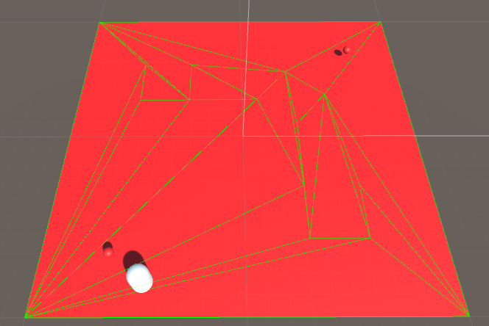
Initial Triangulation

Slide 6
Ideal Endgame
Fix everything
Throw in A* (possibly modified)
Compare results to RRT method
Consider Expanding to multiple agents and avoiding collisions

Slide 7
Questions?
In case you missed it: Anthony Sermania

